Slide 1
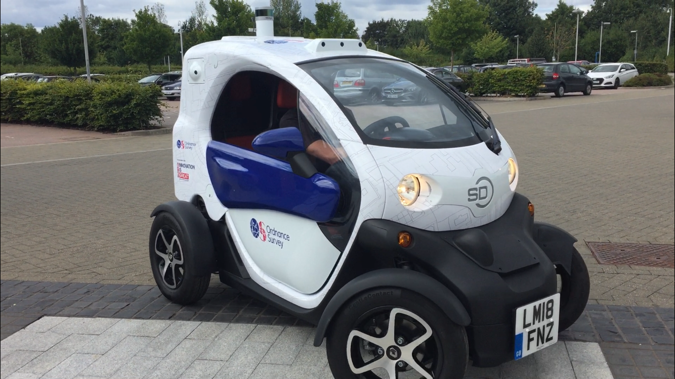
OGC CityGML and GeoPose in Khronos glTF A Proof-of-Concept Experiment
OGC-Khronos Forum
Steve Smyth, OGC CityGML and GeoPose SWGs
July 2022

Slide 2
Vision
Explore path to a widely supported publication format for GeoSemantic Replicas:
Geo = geolocated and oriented
Semantic = segmented and categorized according to human concepts
Replica = usable for computational purposes as a stand-in for the real physical environment
where Visualization “just works” on most platforms, and
Positioning, Navigation. Analysis, Archive, and Simulation work for specialized applications.

Slide 3
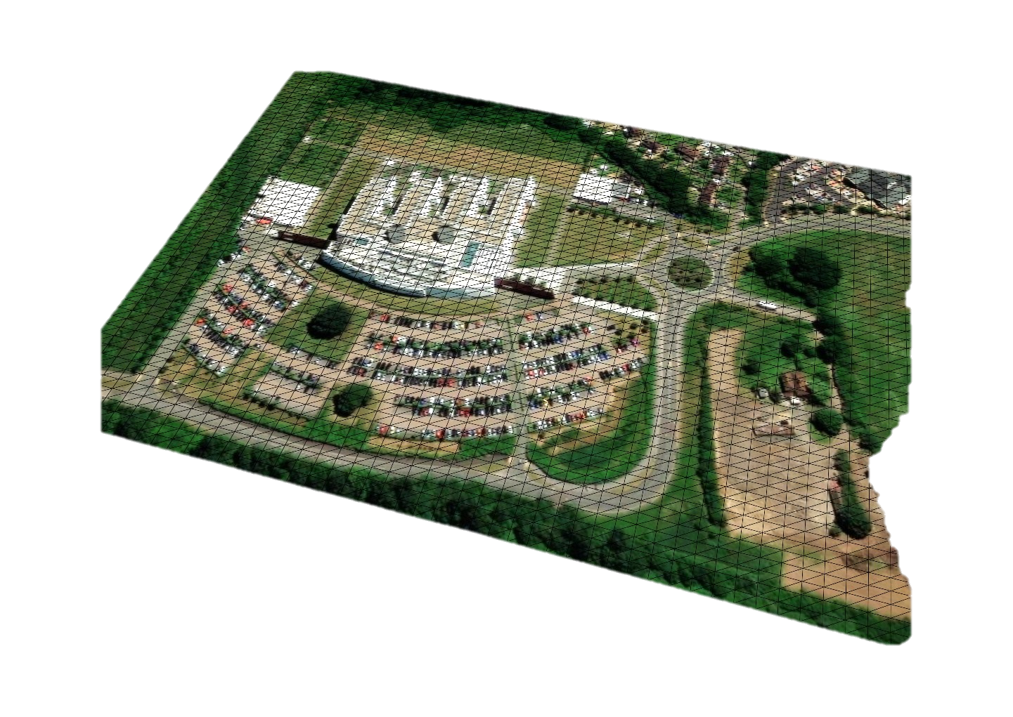

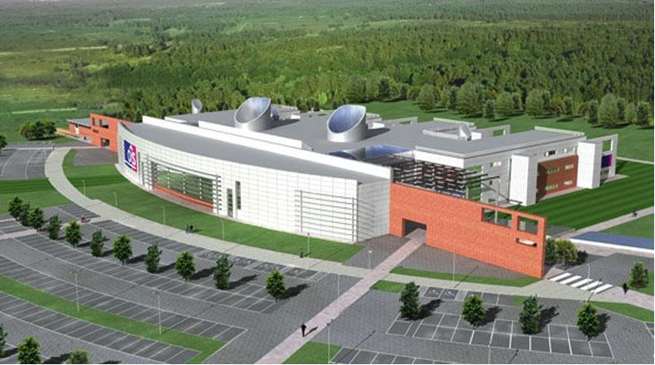
CityGML and GeoPose in glTF PoC Experiment
The GB Ordnance Survey has a “Street Drone” – a Renault Twizy – used for autonomous vehicle R&D at their Southampton UK HQ

Slide 4
CityGML and GeoPose in glTF PoC Experiment
Street Drone Test Run
One test carried out on a perimeter road is the basis of the proof-of-concept experiment: Street Drone run Tue Jul 16 2019 .
Goals
To map the space and material properties of the stationary and movable parts of the OS test area from an OGC CityGML 3.0 GML model to extended glTF.
To use OGC GeoPose 1.0 to locate and orient the model with respect to the planet.
To use OGC GeoPose 1.0 sequences, both Streams and Series, to animate the moving or mobile features (the drone, other vehicles, people, gates, sun), also serialized as glTF, observed during the test run.
To summarize the findings as a report proposing a roadmap for formal integration of the two OGC standards with Khronos glTF.

Slide 5
CityGML and GeoPose in glTF PoC Experiment
Deliverables
A Khronos glTF 2.0-encoded OGC CityGML 3.0 model of the Ordnance Survey test area, Street Drone, and other mobile elements located and oriented with GeoPose 1.0.
A web-hosted animation reproducing the video driven by GeoPose sequences and streams.
A draft spec for a glTF encoding of CityGML 3.0 – at least Core, Relief, PointCloud, City Furniture, Vegetation, Construction, Transportation, and Building Modules.
Support: Dani Elenga Foundation
Thank you.
Participation
OGC-Khronos Forum meetings – meet when there is a need.
GitHub.

Slide 6
CityGML and GeoPose in glTF PoC Experiment
Strategy
Mapping CityGML 3.0 Core Module Spaces to “native” glTF to:
support 3D visualization “natively” with generic glTF loaders/viewers and
to use glTF extensions to extend semantic modelling capabilities.
Using glTF extensions to decorate glTF properties with per-module semantics with
either
one extension for Core Module concepts.
one extension per CityGML semantic (thematic) module.
one extension per CityGML Application Domain Extension (ADE).
or
one extension for everything.

Slide 7

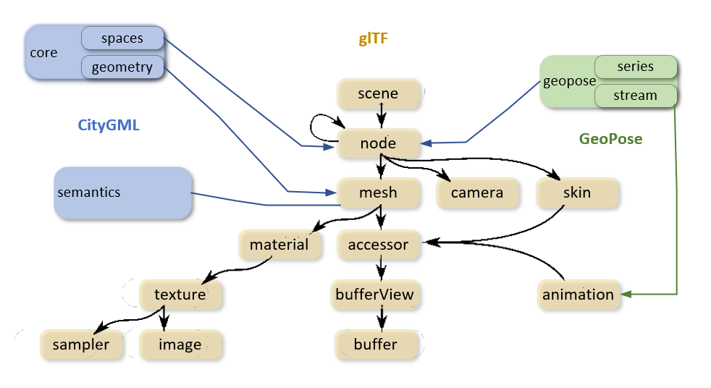


CityGML and GeoPose in glTF PoC Experiment

Slide 8
Timeline
June: Start, establish Principles, deliver functional “Hello World” glTF encoding for OS HQ.
Publish functional replicas to GitHub repo, demonstrating encoding of the Core and additional CityGML modules:
July: Relief and Water
August: Transportation, Furniture, and Vegetation
September: Building and Construction.
October: Animate OS Street Drone via GeoPose input.
November: Add GeoPose target sequences for features (vehicles, furniture, people) visible to forward-facing camera.
December: Report on experiment.
Propose formal standardization based on the experiment results and feedback.

Slide 9
Results: Principles
All of CityGML 3.0 in glTF should be encoded (or plausibly encodable).
A replica should have complete visualization functionally in off-the-shelf glTF loaders and viewers.
GeoPose 1.0 should be used wherever the underlying concept is expressed, for example in the relationship between a world geodetic reference frame and glTF coordinates or in the anchoring of dynamic or virtual features withing the modelled environment.
Remote content storage should be used, if required to obtain an efficient encoding.

Slide 10
Results: “Hello World” Implementation
GeoPose positions and orients the glTF coordinate system in a world external reference frame.
ENU-LTP is a natural reference frame for people and other entities oriented to local gravity.
GeoPose orientation handles the rotational relationship between ENU-LTP and glTF x, y, z coordinates.
CityGML metadata incorporated via glTF extension properties are attached to “scenes”: view JSON here.
A rectangular bounding volume calculated from the metadata and visualized in glTF coordinate frame: view it here.

Slide 11

CityGML and GeoPose in glTF PoC Experiment

Slide 12
Q&A
Thank you.

